Slide 1
BT 601: Analytical Biotechnology
-Prof. Siddhartha Sankar Ghosh
Lec-6

Slide 2


Slide 3
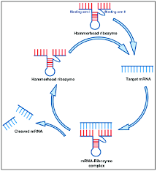
Ribozymes
Ribozymes (ribonucleic acid enzymes) are RNA molecules that have the ability to catalyze specific biochemical reactions, including RNA splicing in gene expression, similar to the action of protein enzymes.

Slide 4
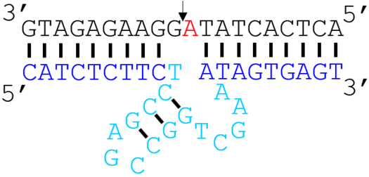
Deoxyribozymes
Deoxyribozymes, DNA enzymes or simply DNAzymes are single-stranded oligo-deoxyribonucleotide molecules that, like proteins and ribozymes, possess the ability to perform specific chemical reaction.
DNAzymes have not yet been found in living organisms, they have been isolated in the laboratory through in vitro selection.
The trans-form (two separate strands) of the DNAzyme. Most ribonuclease DNAzymes have a similar form, consisting of a separate enzyme strand (blue/cyan) and substrate strand (black). Two arms of complementary bases flank the catalytic core (cyan) on the enzyme strand and the single ribonucleotide (red) on the substrate strand. The arrow shows the ribonucleotide cleavage site

Slide 6
Ribozymes
Ribozymes (ribonucleic acid enzymes) are RNA molecules that have the ability to catalyze specific biochemical reactions, including RNA splicing in gene expression, similar to the action of protein enzymes.

Slide 7
Deoxyribozymes
Deoxyribozymes, DNA enzymes or simply DNAzymes are single-stranded oligo-deoxyribonucleotide molecules that, like proteins and ribozymes, possess the ability to perform specific chemical reaction.
DNAzymes have not yet been found in living organisms, they have been isolated in the laboratory through in vitro selection.
The trans-form (two separate strands) of the DNAzyme. Most ribonuclease DNAzymes have a similar form, consisting of a separate enzyme strand (blue/cyan) and substrate strand (black). Two arms of complementary bases flank the catalytic core (cyan) on the enzyme strand and the single ribonucleotide (red) on the substrate strand. The arrow shows the ribonucleotide cleavage site

Slide 8
Mode of Operation
E
F

Slide 9
An Autonomous DNA Nanomotor Powered by a DNA Enzyme

Slide 10
Gel Electrophoresis Study

Slide 11
Motion of the DNA motor

Slide 12
THANK YOU

